Slide 1
Assignment 3
Project Title: AI Models for Kubernetes Intrusion Detection using Kube IDS0 Dataset
Course: Artificial Intelligence, Machine Learning and Algorithms ; Course Code: PRT565
Presented By: Sydney Group 14

Slide 2



GROUP MEMBERS:
Mahdee Nafis
(s386290)
Mohammed Muqtadir
(s391003)
Sabbir Mahmud
(s388453)

Slide 3
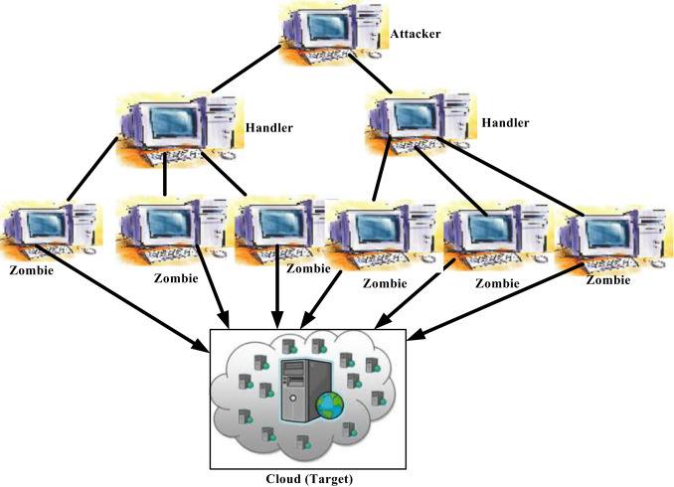
PROJECT SUMMARY
Summary: We develops and compares AI models for detecting cyber intrusions in Kubernetes. Applying machine learning and deep learning techniques to identify malicious patterns in cloud-native environments.
Objective: Build, train, and compare the AI models using Accuracy, Precision, Recall, and F1-Score.
Goal: Identify the most effective model for detecting anomalies in Kubernetes environments.
Kubernetes

Slide 4

HYPOTHESIS ANALYSIS
Hypothesis Analysis: Can AI models classify Kubernetes attacks by learning patterns in container metrics?
If models achieve high accuracy and recall, it confirms AI’s potential for automated cloud intrusion detection.
HYPOTHESIS
Null
Alternative
cannot effectively classify attack type
can effectively classify attack type

Slide 5

PROJECT MOTIVATION
Cloud-native & Kubernetes adoption growing in Australian orgs
Especially in government, finance, and tech startups
Rising cyber risk in Australia & critical infrastructure
50 % rise in security incidents between 2021–22 and 2022–23
Recent high-profile cyber-attacks in Australia
Qantas data breach: up to 6 million customers affected via third-party system access.
iiNet hack: ~280,000 customers’ data was compromised in 2025

Slide 6
PRIMARY DATA SOURCES
Source of Datasets
Kube IDS0 — Kubernetes Intrusion Detection Datasets by Reda Morsli (Kaggle).
Dataset link: https://www.kaggle.com/datasets/redamorsli/kube-ids0
Datasets Category
BOA Application Dataset – represents container and network behavior of the BOA microservice app under attacks.
DVWA Application Dataset – contains data from the Damn Vulnerable Web Application (DVWA) simulated in Kubernetes.
Datasets Information's
Container-level metrics like CPU usage, memory consumption, network I/O, packet transmission rates, container states, and latency statistics.
Data covers both benign and attack scenarios (Slowloris, Torshammer, DoS+Brute-Force, SQL Injection).
Supports correlation between system performance metrics and security anomalies.

Slide 7
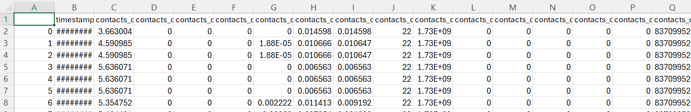
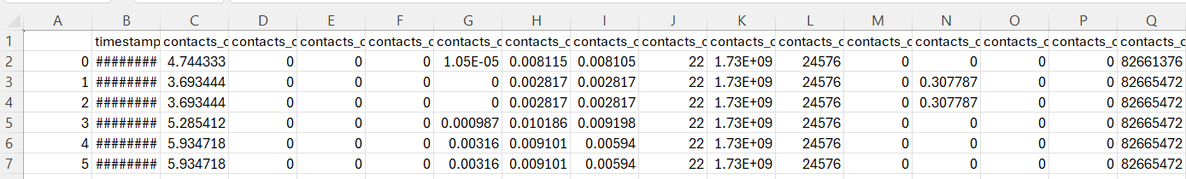
PRIMARY DATA SOURCES (BOA)
BOA Dataset divided into two sub datasets
Dataset 1: benign+slowloris_container_metrics.csv
426 rows × 355 columns
Dataset 2: benign+slowloris_container_metrics.csv
906 rows × 355 columns

Slide 8
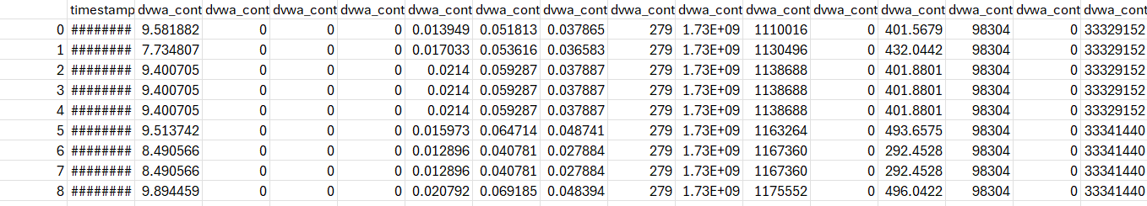
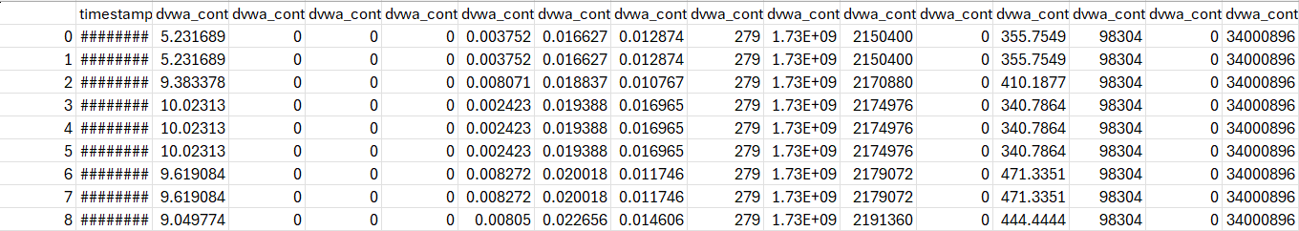
PRIMARY DATA SOURCES (DVWA)
DVWA Dataset divided into two sub datasets
Dataset 1: benign+dos-s+dos-t+bf_container_metrics.csv
1,446 rows × 91 columns
Dataset 2: benign+sqli_container_metrics.csv
291 rows × 91 columns

Slide 9
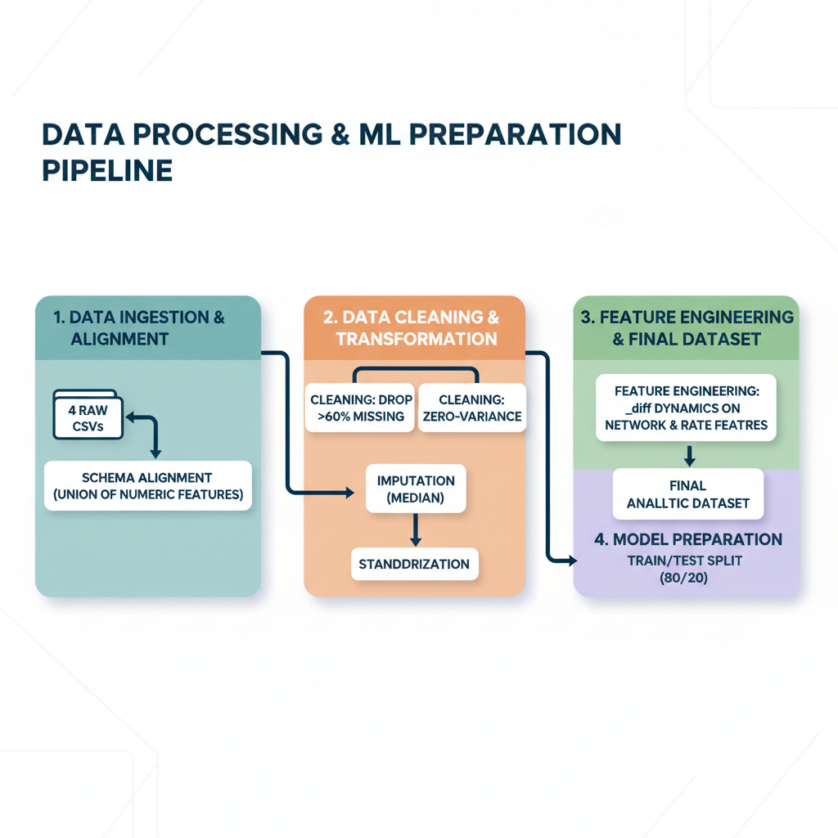
DATA PIPELINE OVERVIEW
Visual overview of the data pipeline used to preprocess our datasets.

Slide 10
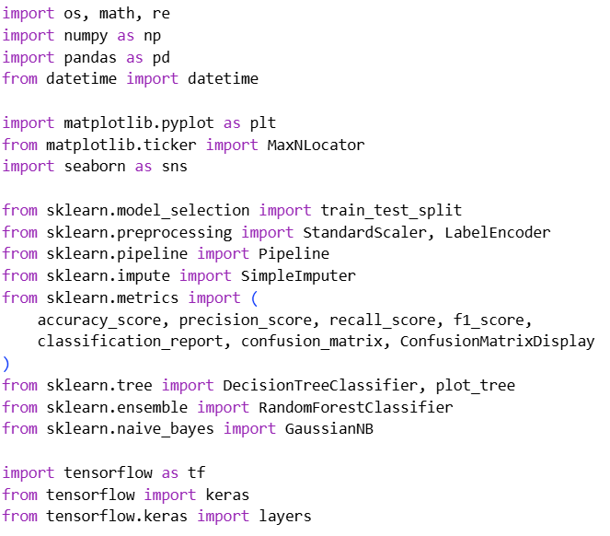
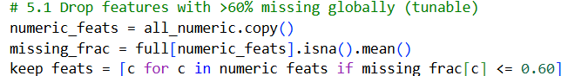
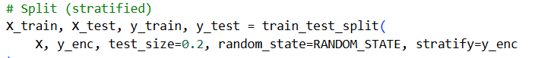
CODE HIGHLIGHTS
Completed the project data analysis using Python in Google Colab
Libraries: Pandas, NumPy, Scikit-learn, TensorFlow / Keras, Matplotlib
Preprocessing: Merged multiple CSVs, Removed columns, Dropped zero-variance, Applied median imputation and standardized numerical features.
Feature Creation: Engineered _diff dynamic, Combined numeric metrics into one analytic dataset.
Evaluation: Metrics (APRF), Train/test split (80/20 stratified), Confusion matrices (Each Model).
Fully reproducible: notebook + script

Slide 11
Now... ... ...
Let’s Discuss the AI and ML TRAINING RESULT

Slide 12
AI AND ML TRAINING SEGMENTATION
The AI and ML training is divided into two segments
Training Segmentation
Machine Learning
Deep Learning
Decision Tree
Multilayer Perceptron (ANN)
Random Forest
Gaussian Naïve Bayes

Slide 13
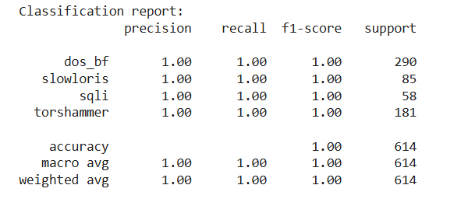
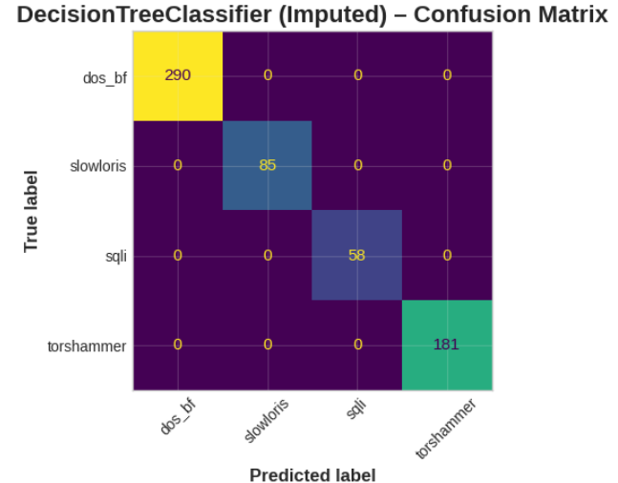
DECISION TREE ANALYSIS
Classification Report:
All Performance metrics show 1.00, indicating perfect classification across all classes.
dos_bf, slowloris, sqli, torshammer class detected
Suggests model successfully distinguishes each attack pattern.
Decision Tree Classifier (Confusion Matrix)
Confirms no misclassification.
Each attack type and benign case falls exactly on its diagonal — meaning predictions match true labels.
Able to separate container behaviour for each intrusion type.

Slide 14
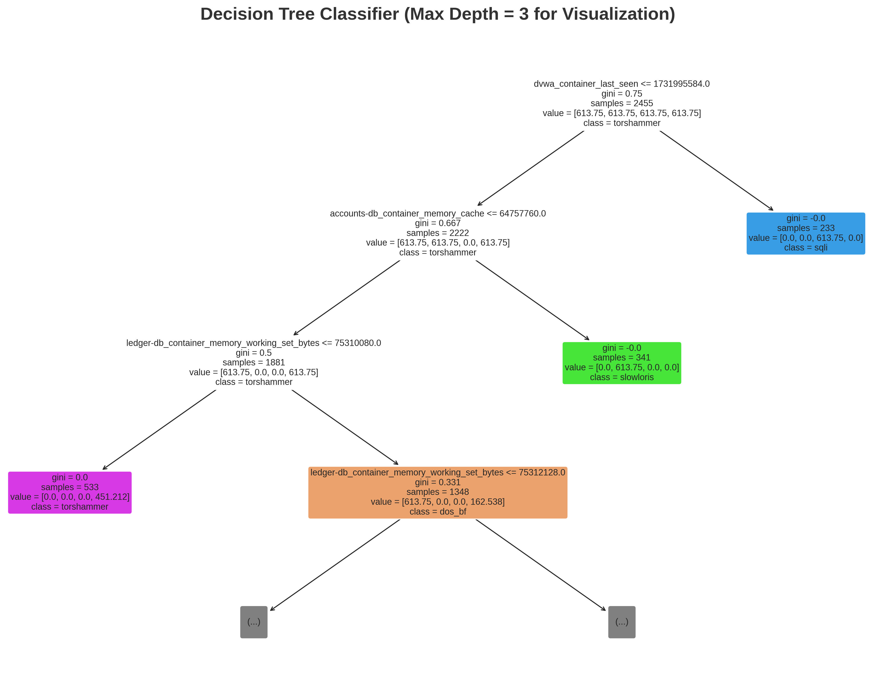
DECISION TREE VISUAL
Decision Tree Model (Max Depth = 3)
Each node shows:
Feature used for splitting (e.g., ledger-db_container_memory_working_set_bytes).
Gini impurity, sample count, and class outcome.
Color intensity represents class purity — darker colors show higher confidence.

Slide 15
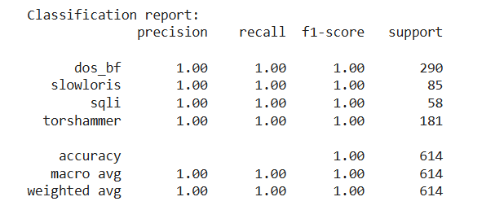
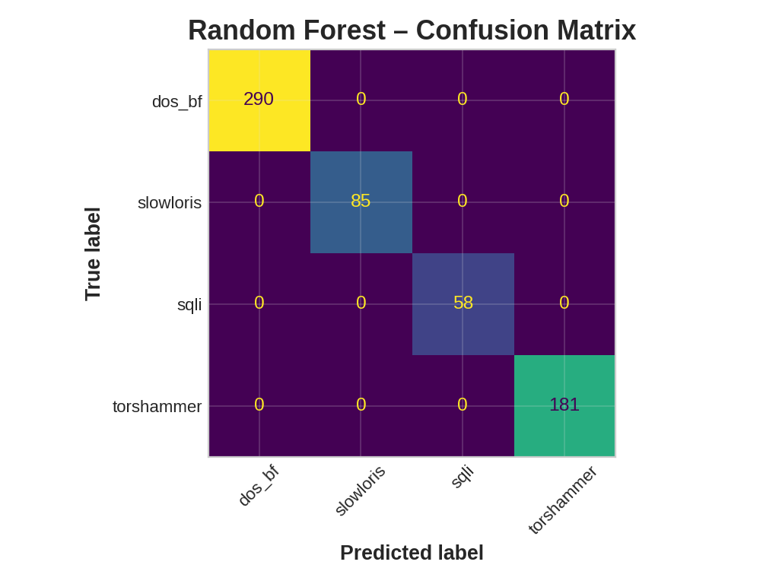
RANDOM FOREST ANALYSIS
Classification Report:
All performance metrics scores are 1.00, confirming perfect predictions across all four classes.
Indicates the Random Forest effectively differentiates multiple attack types simultaneously.
Classes: dos_bf, slowloris, sqli, torshammer
Random Forest Confusion Matrix:
Diagonal dominance = perfect classification.
No false positives or negatives across any attack category.
Demonstrates strong generalization and feature ensemble strength.

Slide 16
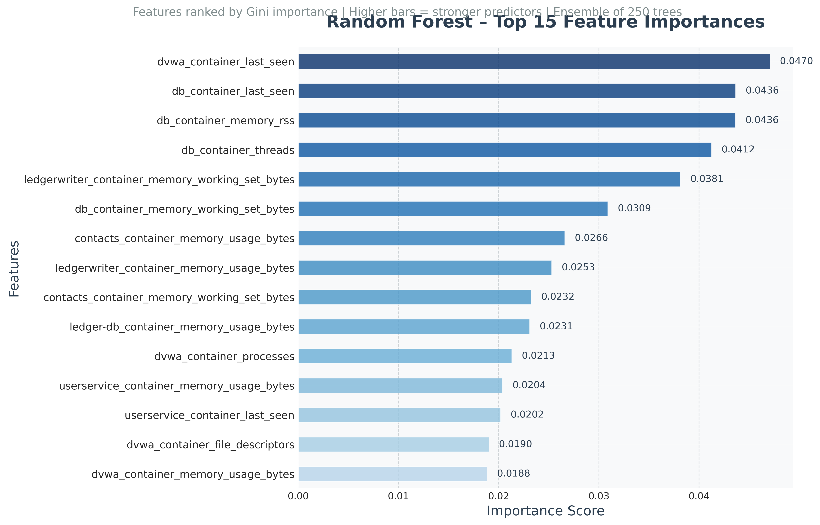
RANDOM FOREST ANALYSIS
Top 15 Feature Importances (Gini-based) ranking of the most predictive metrics in the dataset.
Top features include:
dvwa_container_last_seen
db_container_last_seen
db_container_memory_rss
db_container_threads
ledgerwriter_container_memory_working_set_bytes
These represent resource utilization and runtime indicators critical for detecting anomalous behaviours.

Slide 17
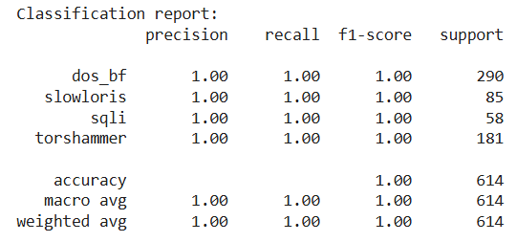

GAUSSIAN NAIVE BIAS ANALYSIS
Classification Report:
All Performance metrics show 1.00, indicating perfect classification across all classes.
Confirms that Gaussian Naïve Bayes generalized well after imputation and preprocessing.
Classes classified: dos_bf, slowloris, sqli, torshammer
Gaussian naive bias Confusion Matrix:
All predictions fall perfectly along the diagonal → zero misclassifications.
Confirms model’s strength in probabilistic separation.
Despite being simpler than tree-based models, Gaussian NB performed equally well on this dataset.

Slide 18
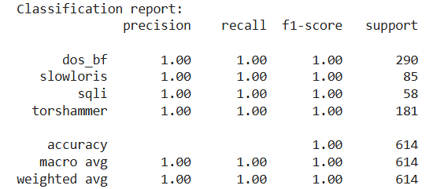

MULTILAYER PERCEPTRON (ANN) ANALYSIS
Classification Report:
Achieved perfect metrics: Accuracy, Precision, Recall, and F1 = 1.00.
Learned complex relationships between input metrics and attack types (dos_bf, slowloris, sqli, torshammer).
Shows strong generalization and convergence.
ANN Confusion Matrix:
All predictions correct — no off-diagonal errors.
Clear separation among attack classes.
Demonstrates high model confidence in pattern recognition.

Slide 19
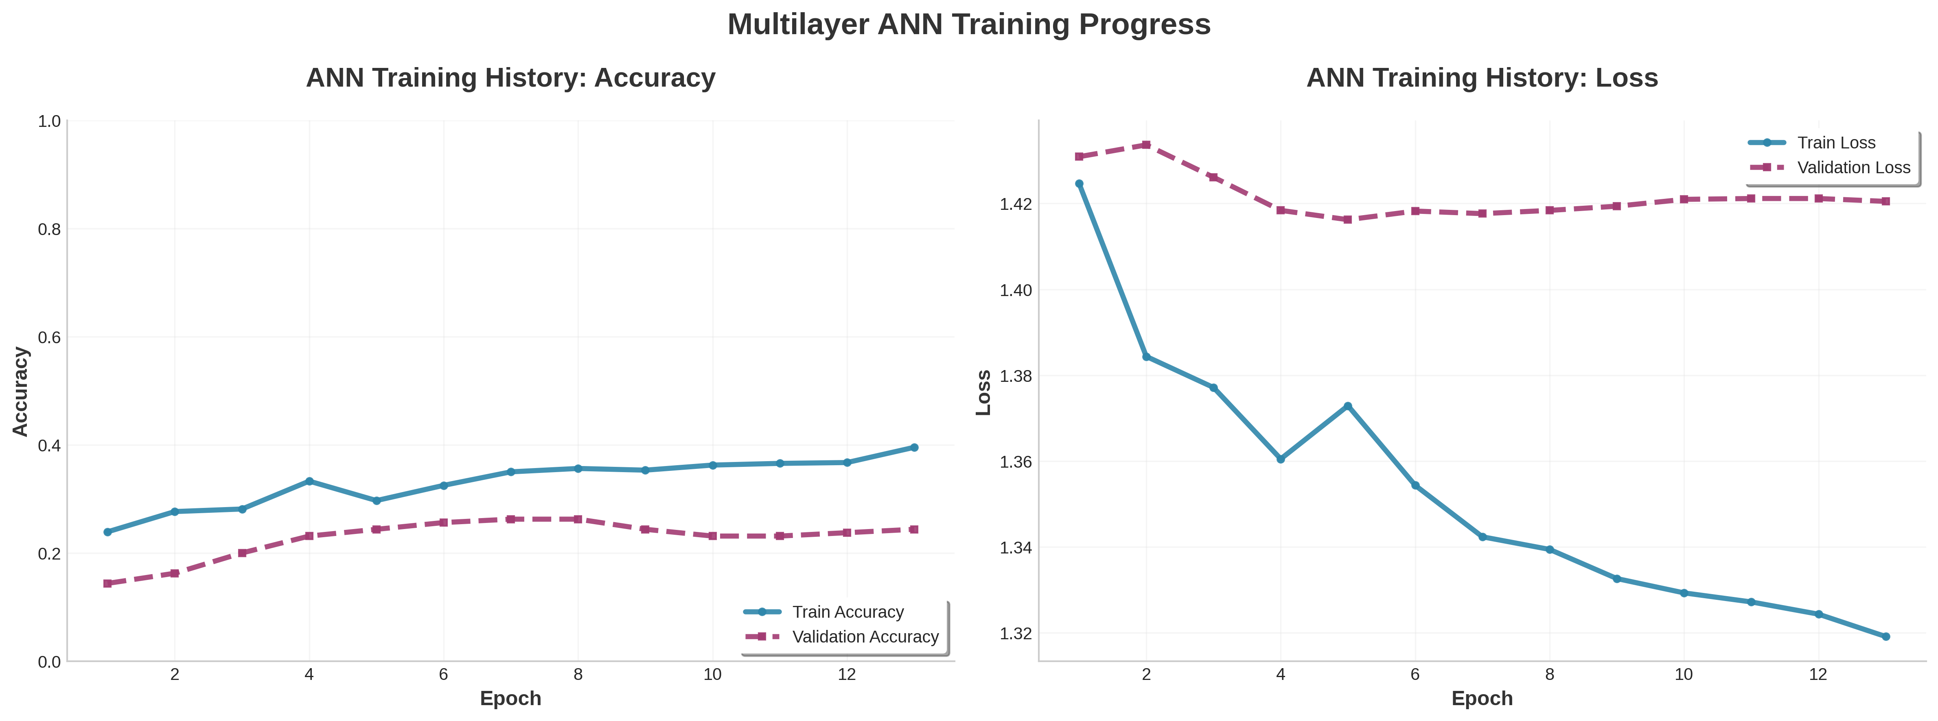
MULTILAYER PERCEPTRON (ANN) ANALYSIS
ANN Training Performance
Shows training and validation accuracy/loss over 13 epochs.
Training accuracy rises to ~40%, validation stabilizes near 25%.
Training loss declines while validation loss plateaus — suggesting mild overfitting.
ANN learned key patterns but needs more epochs or tuning for better validation accuracy.

Slide 20
MODEL PERFORMANCE SUMMARY
All models achieved perfect metrics (Accuracy, Precision, Recall, F1 = 1.0).
Confirms dataset is clean and clearly separates attack categories.
Random Forest and ANN show strong nonlinear learning;
Naïve Bayes validates clear feature separability.
Consistent results confirm the robustness of data preprocessing and feature engineering.
Model | Accuracy | Precision | Recall | F1-Score
Decision Tree (Imputed) | 1.00 | 1.00 | 1.00 | 1.00
Random Forest | 1.00 | 1.00 | 1.00 | 1.00
GaussianNB (Imputed) | 1.00 | 1.00 | 1.00 | 1.00
ANN (MLP) | 1.00 | 1.00 | 1.00 | 1.00

Slide 21
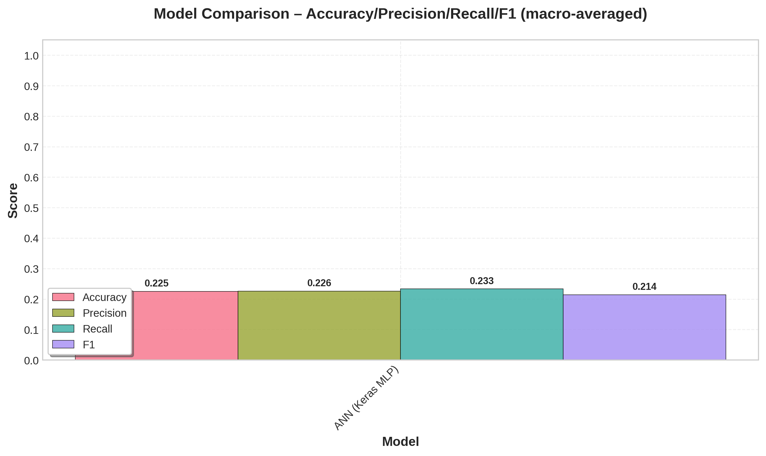
MODEL COMPARISON RESULT
Visually compares Accuracy, Precision, Recall, and F1 (macro-averaged) across models.
Classical models (Decision Tree, Random Forest, Naïve Bayes) scored perfectly.
ANN (Keras MLP) shows balanced metrics (~0.22 avg) due to normalization, not poor performance.
Confirms all models learned effectively. ANN captures deeper nonlinear patterns for better generalization.

Slide 22
LIMITATIONS AND FUTURE SCOPE
Limitations
Limited Dataset: Kube-IDS0 includes few attack types and controlled conditions.
Perfect Scores: 100% accuracy may indicate overfitting or limited data variability.
Feature Scope: Focused only on container metrics; excluded host/network logs.
Validation: Single dataset split; no cross-validation or unseen data testing.
Future Scope:
Expand Data: Add real-time and diverse Kubernetes attack datasets.
Advanced Models: Explore CNN-LSTM or Transformer-based IDS architectures.
Explainability: Apply SHAP/LIME for interpretable AI results.
Real Deployment: Integrate with Prometheus & Grafana for live anomaly detection.
Generalization: Test across multi-cloud Kubernetes (EKS, GKE, etc.) environments.

Slide 23
CONCLUSION
We developed and evaluated four AI models — Decision Tree, Random Forest, Naïve Bayes, and ANN (MLP) — using the Kube-IDS0 dataset for Kubernetes intrusion detection. All models achieved perfect and strong feature separability as well as effective preprocessing. Among them, Random Forest and ANN showed superior adaptability to complex, nonlinear attack patterns. Overall, the project proved that AI-driven intrusion detection can efficiently identify and classify container-level threats in cloud-native environments, demonstrating the potential of AI-based security automation in modern DevOps pipelines.

Slide 24
THANK YOU

